Slide 1
Lab 8 3DOF RW Control
2/3 Body Problem
C2C Gowri Ramaprasad
C2C Derek Weissinger
C2C Owen Crawley
Notes:
https://www.youtube.com/watch?v=jVXgWGK9Kr8

Slide 2
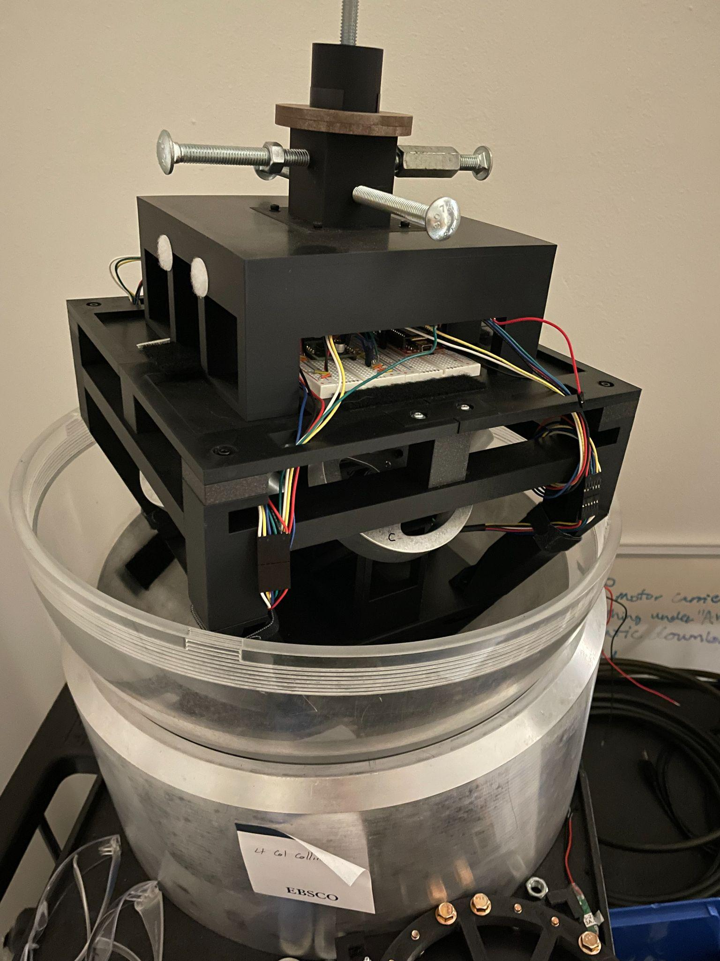
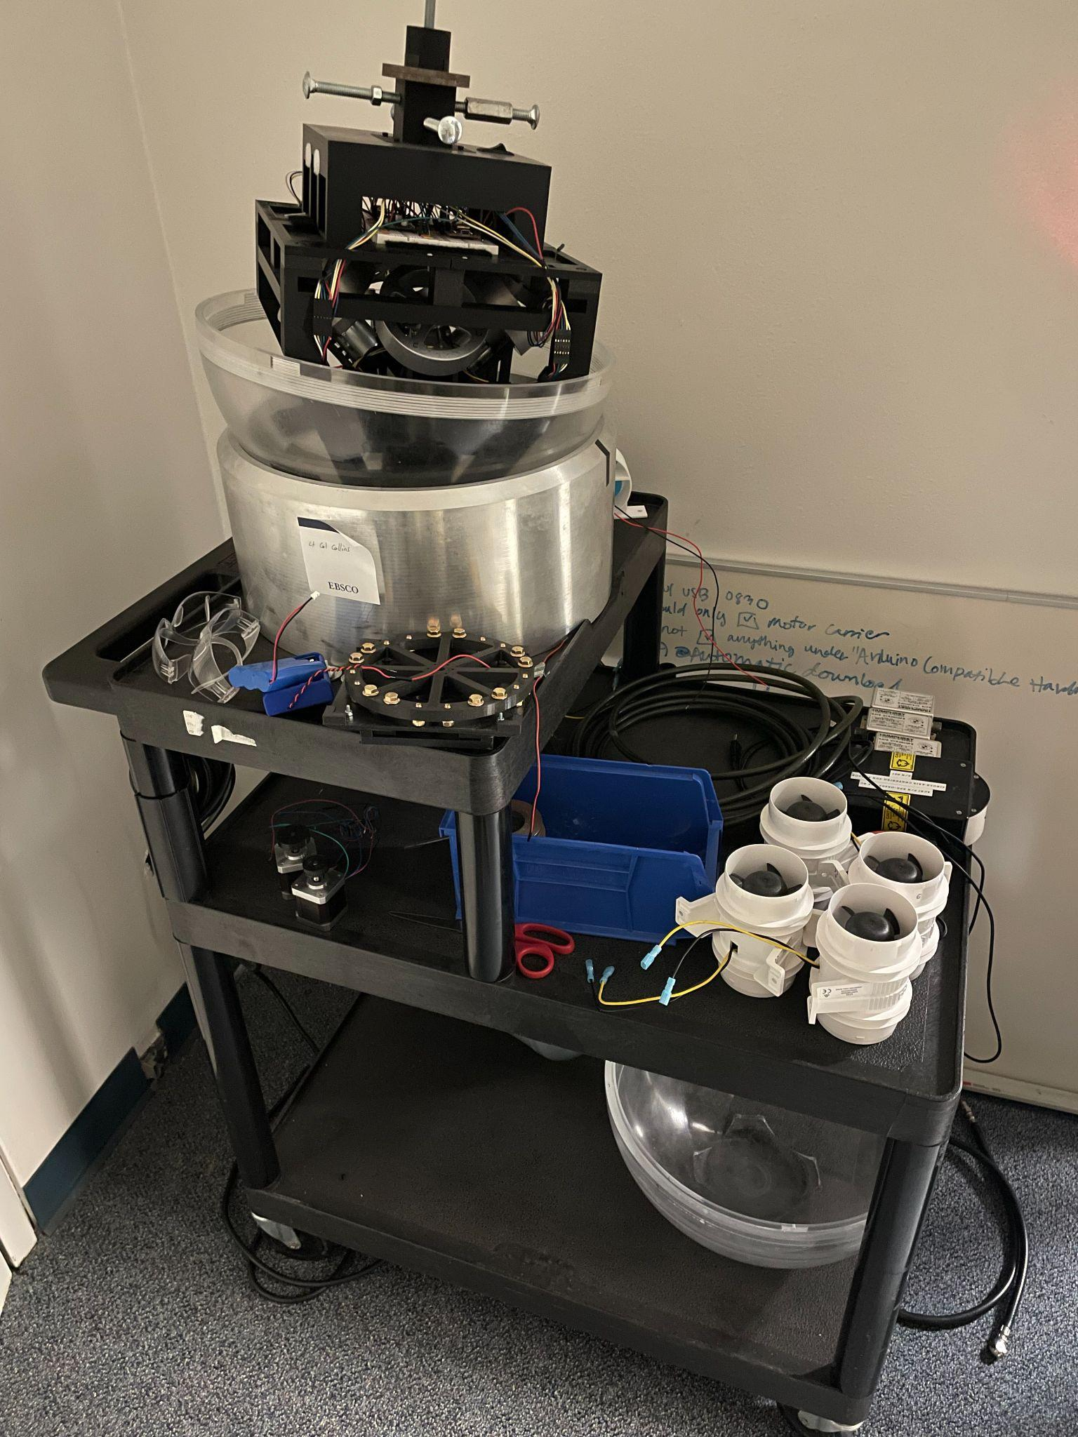
Overview
Using the small air bearing table, develop a reaction wheel control system in 3 degrees of freedom (pitch, yaw, roll).
Develop a robust sensor fusion algorithm using gyroscopes, magnetometers and accelerometers to accurately determine attitude at any given state.

Slide 3
Requirements
Primary Requirements:
The system shall maintain a specified heading without visible jitter or drift.
The system shall be able to determine true attitude +/- 1 degree in all 3 fundamental axes.
The system shall automatically detect simulated or real wheel failure and compensate, still fulfilling above requirements.
Stretch Requirement:
The system shall slew to a series of 4 points following the optimal path, coming within +/- 1 degree of each point in all 3 fundamental axes.

